Slide 1
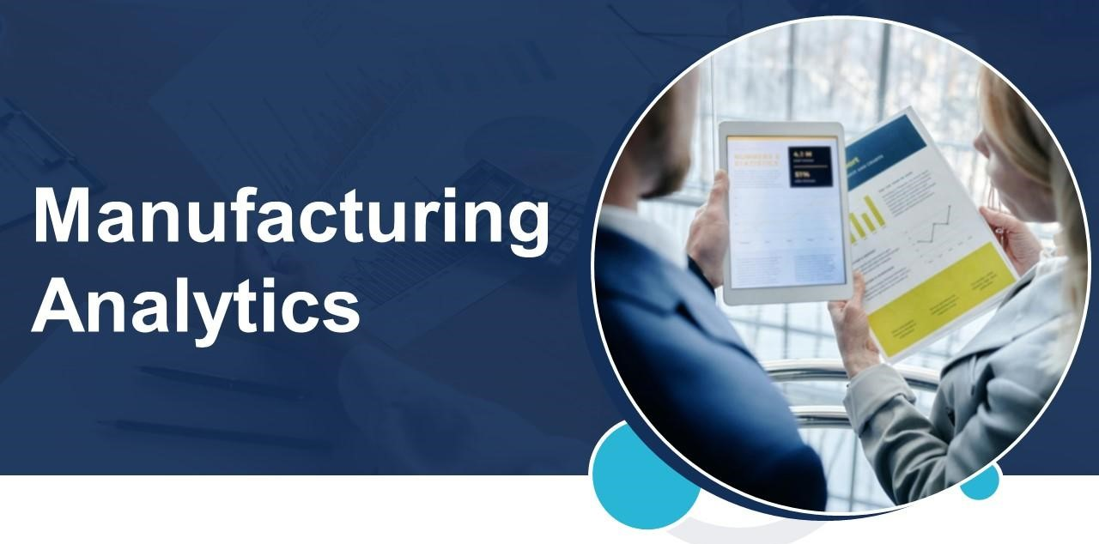

Slide 2
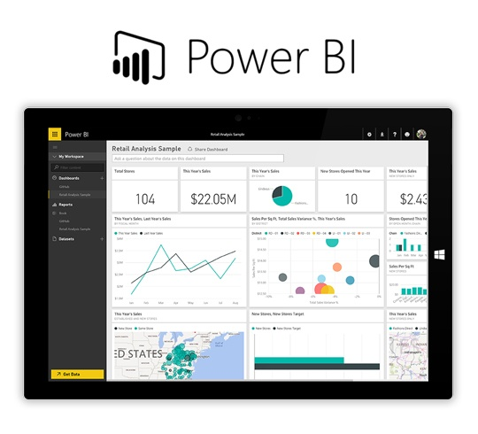
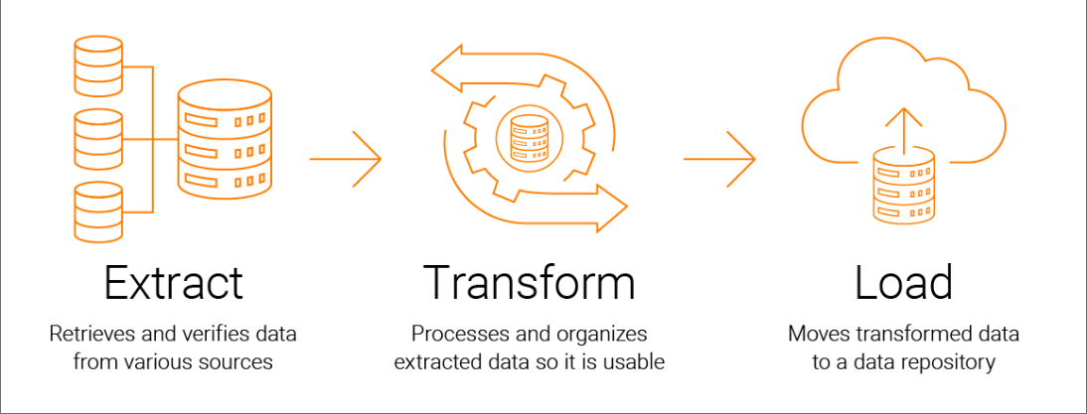
Financials
Sales
Procurement
Inventory
Manufacturing
AR / AP

Slide 3
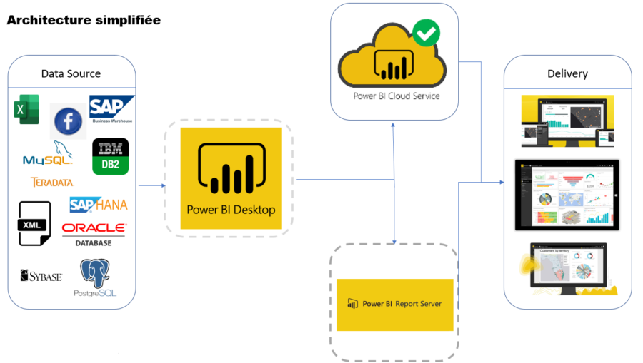

Slide 4
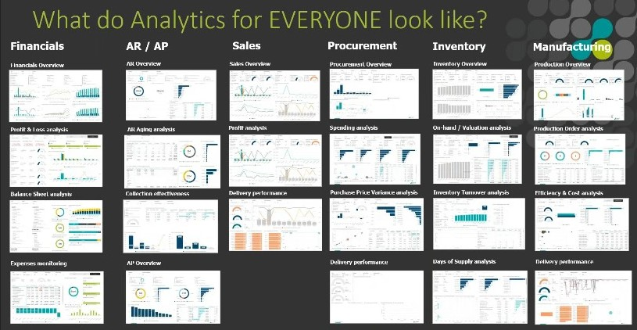

Slide 5
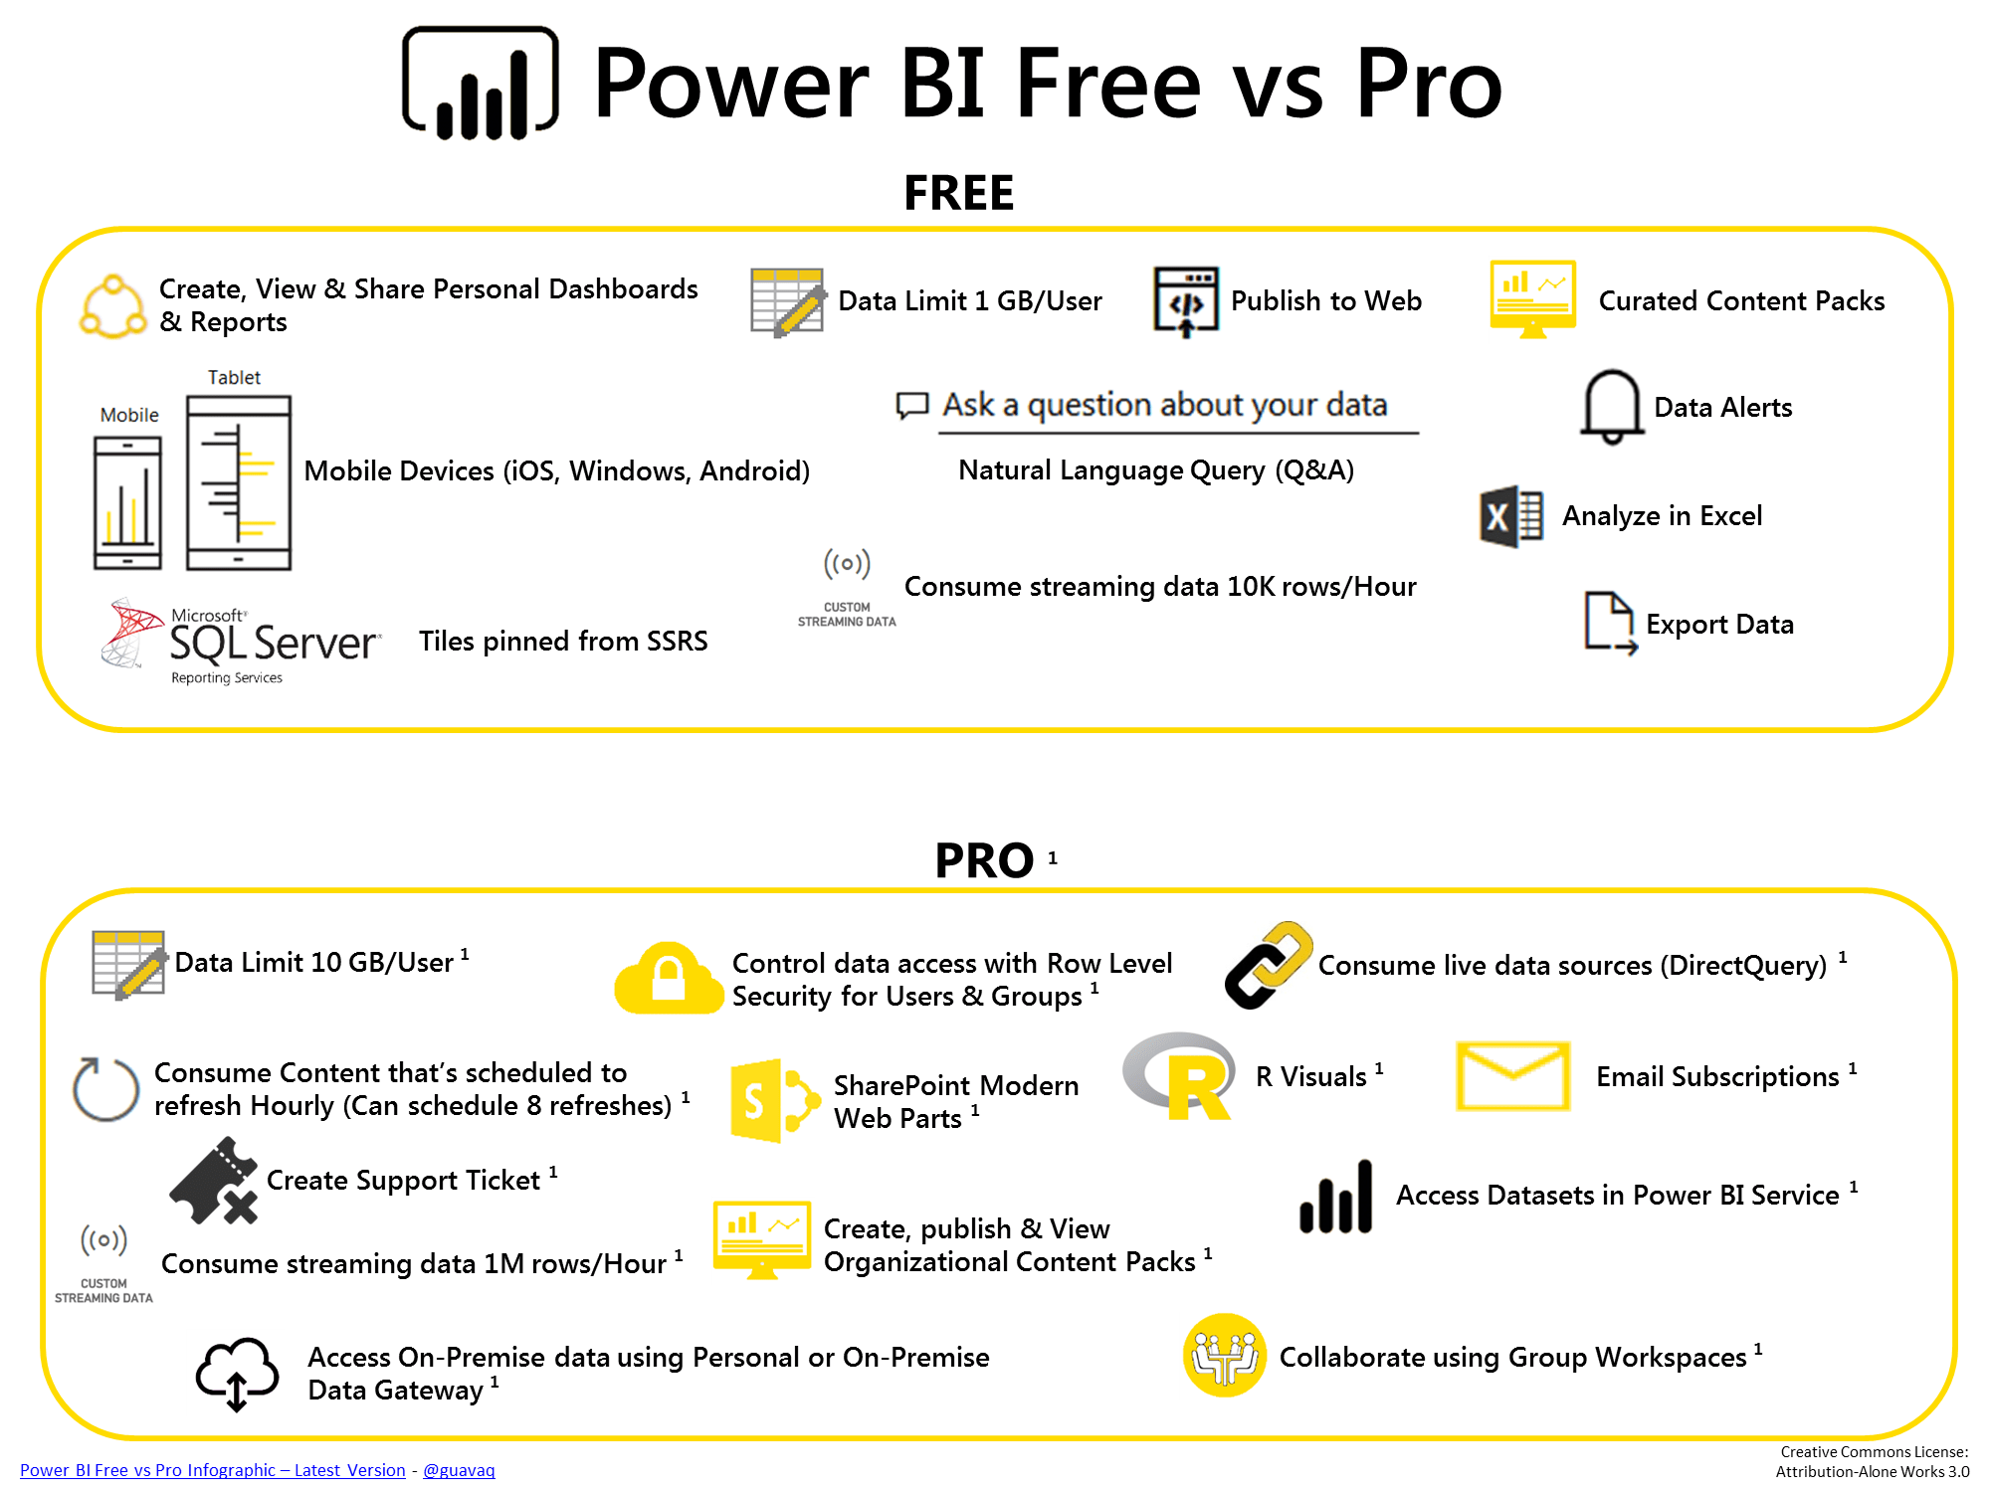

Slide 6
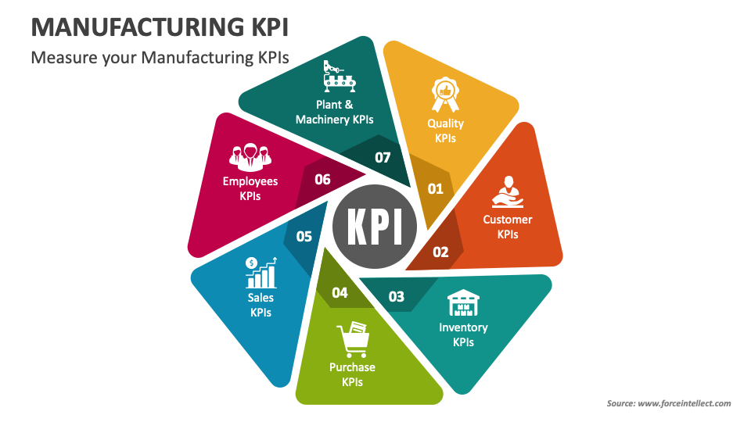

Slide 7
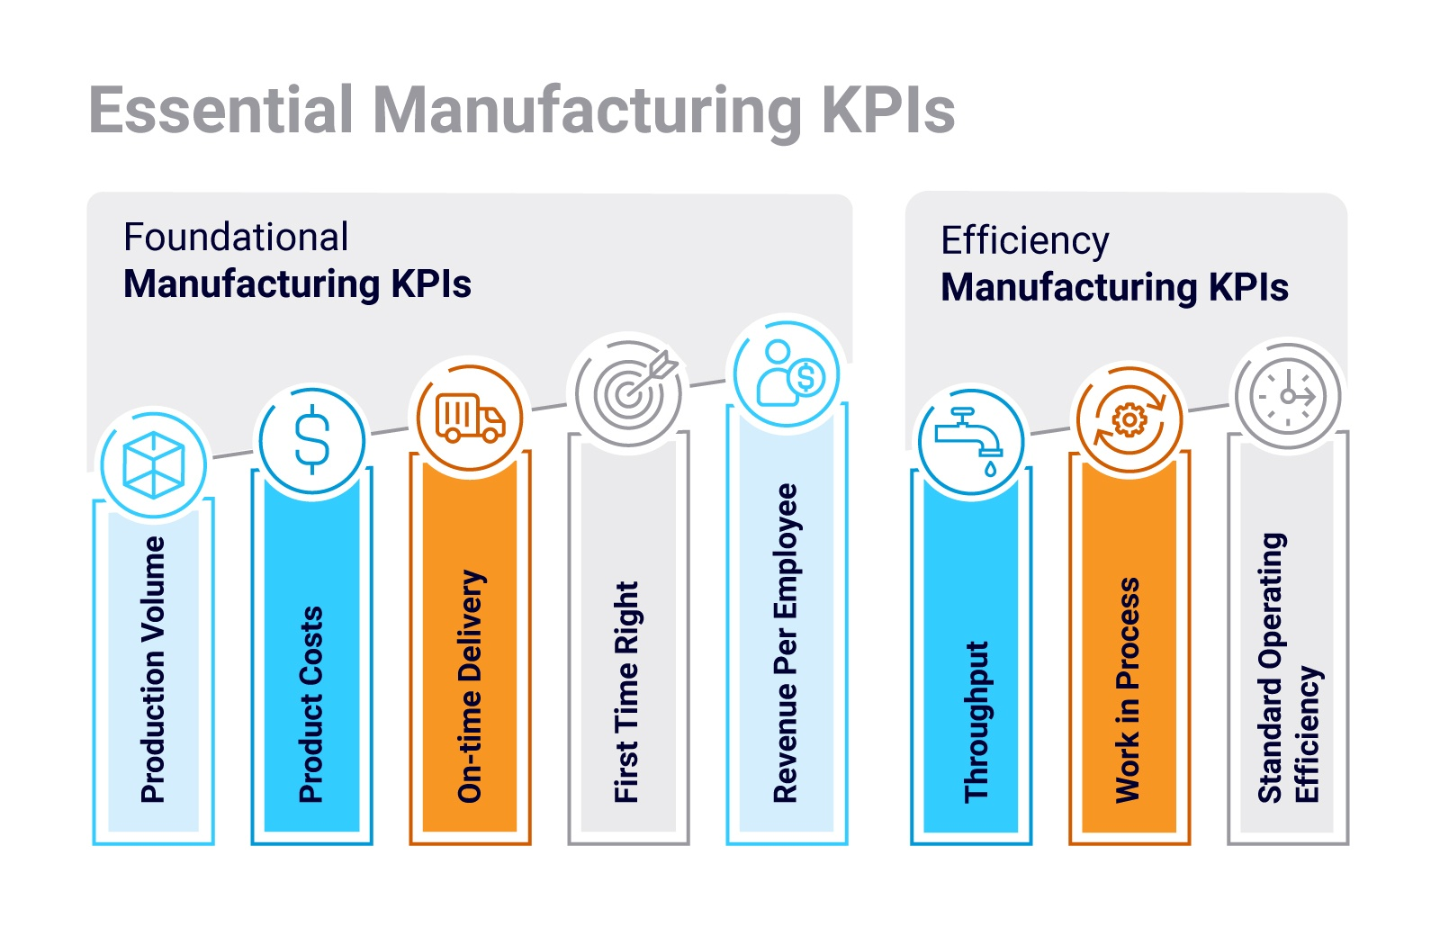
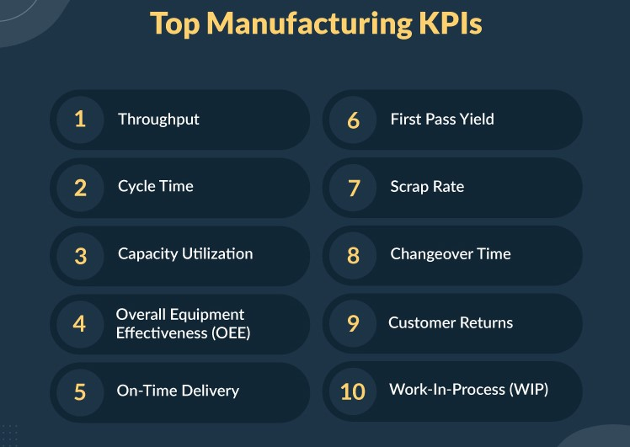
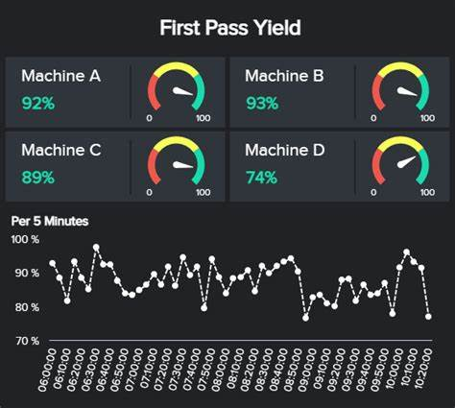

Slide 8
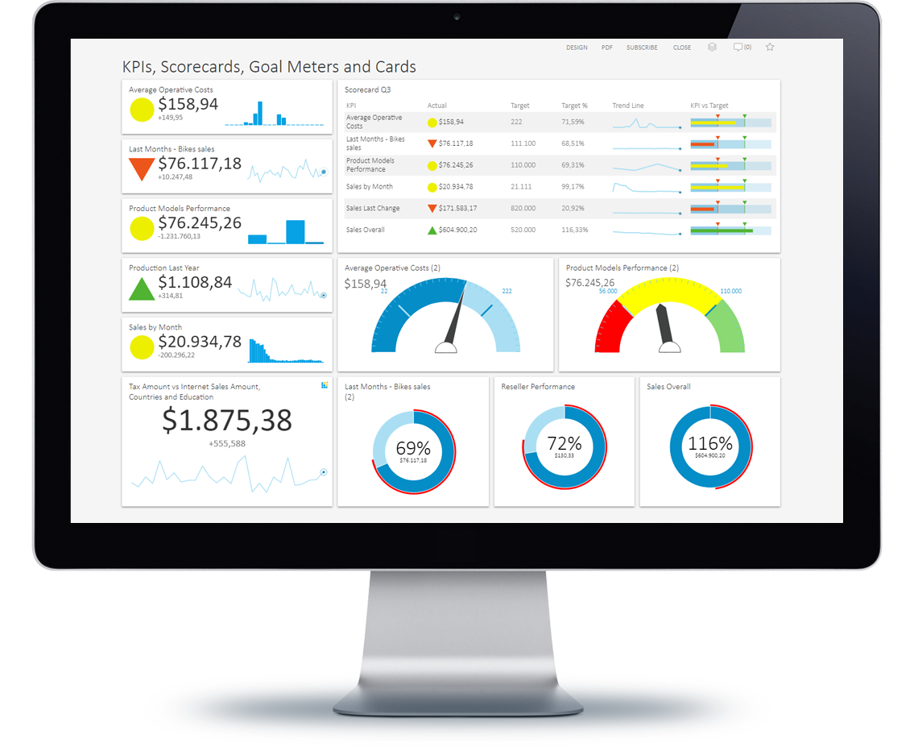

Slide 9
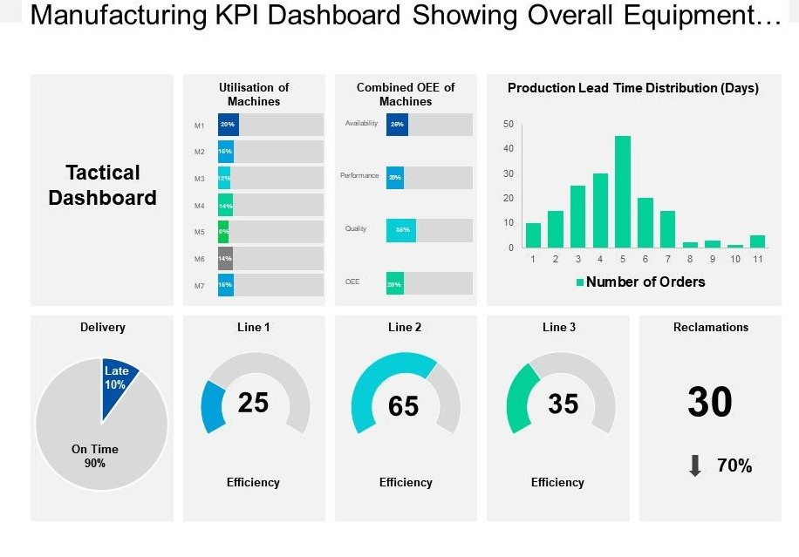

Slide 10
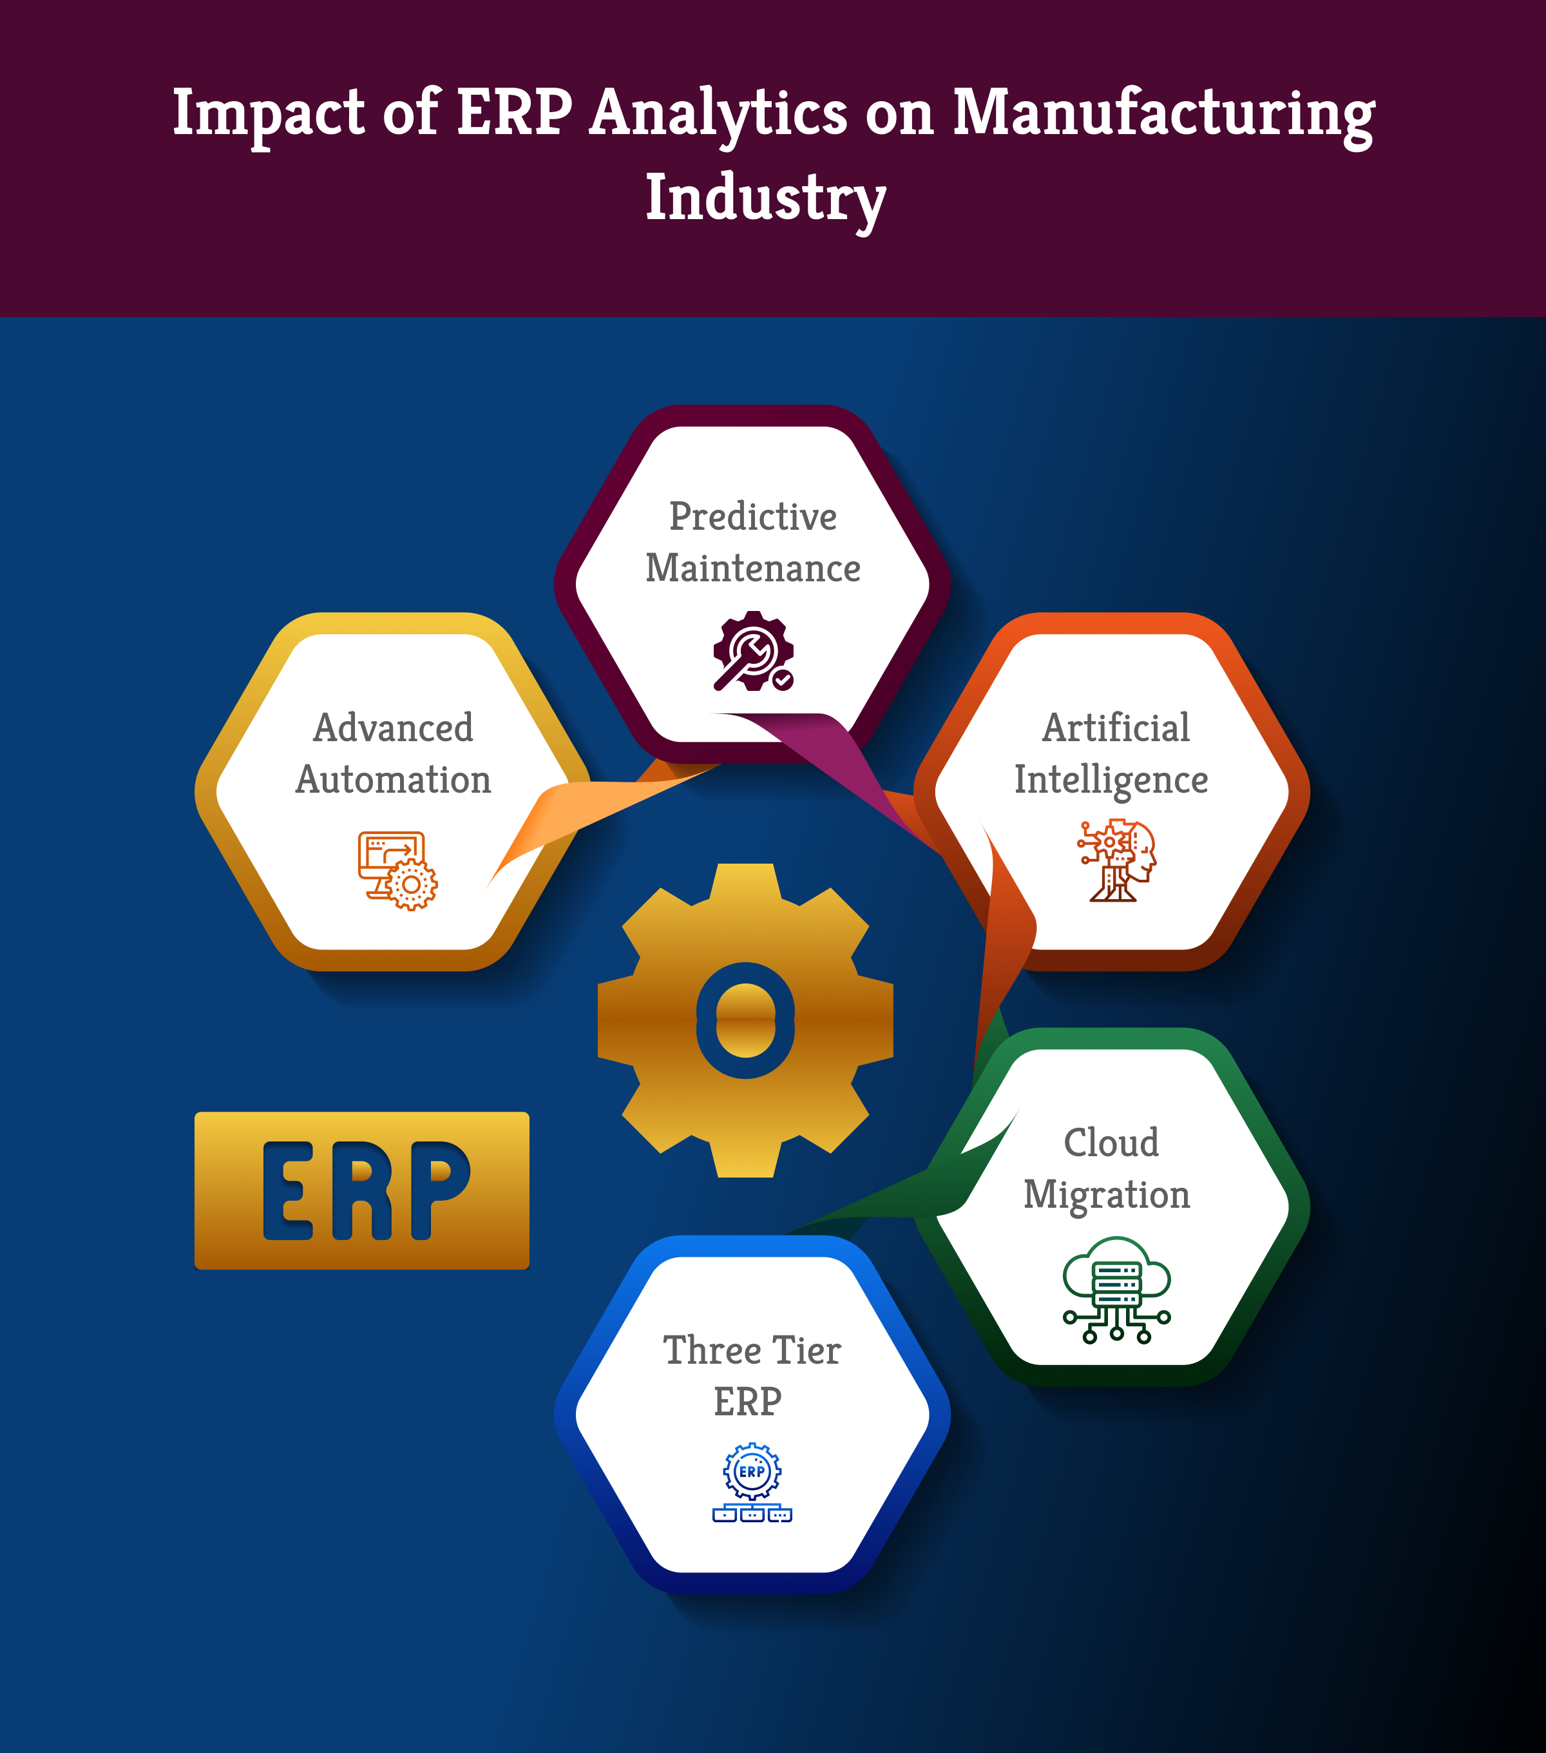

Slide 11
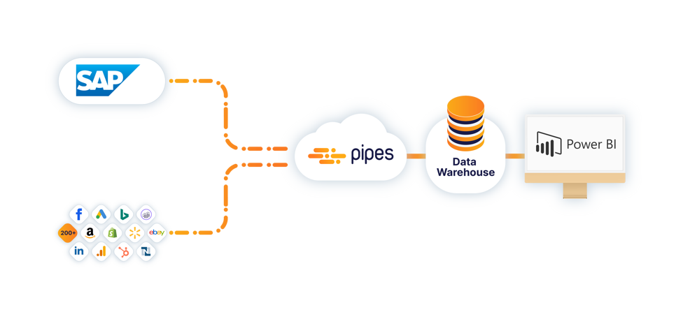

Slide 12
Capabilities Overview We've compared the features of SAS Visual Analytics, SAP BusinessObjects, and Microsoft Power BI to determine the best business intelligence tool in each category. Power BI and SAP lead in feature advantages, but Power BI emerges as the top software overall for its superior visualizations, decision services, and integration abilities.
 | SAP | POWER BI
Data Visualization Data is presented visually for easy interpretation. | ✅ | ✅(ADVANTAGE)
Online Analytical Processing (OLAP) OLAP functionalities provide access to databases and web-based analysis. | ✅(ADVANTAGE) | ✅
Document Management Convert reports into different file formats and share analytical findings. | ✅ | ✅
Decision Services Financial management features provide analysis of monetary information. | ✅ | ✅(ADVANTAGE)
Integrations The ability to connect with other systems provides multiple sources and functionalities. | ✅ | ✅(ADVANTAGE)
Big Data Integration Access big data programs for comprehensive analysis. | ✅ | ✅(ADVANTAGE)

Slide 13
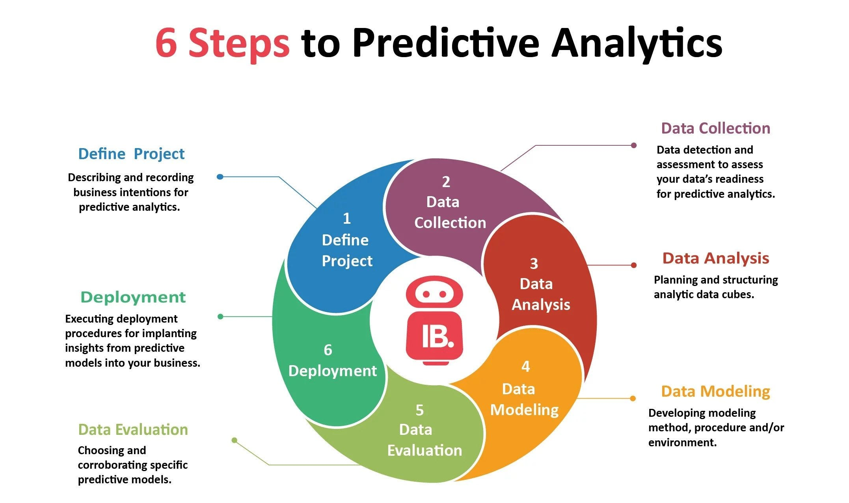

Slide 14
Our Predictive Analysis Offerings in Manufacturing:
Analytics Model | Results
Predictive Maintenance | Predict equipment or machinery failure. Optimize maintenance schedules. Reduce downtime and extend equipment life.
Demand Forecasting | Predict future product demand. Optimize inventory levels and production schedules. Minimize stockouts and overproduction.
Quality Control and Defect Prediction | Predict product defects during manufacturing. Improve product quality and reduce waste. Enhance customer satisfaction.
Supply Chain Optimization | Predict supply chain disruptions. Optimize material and product flow. Enhance supply chain resilience.
Energy Consumption Optimization | Predict and optimize energy usage. Reduce energy costs and enhance sustainability. Meet regulatory compliance.
Production Planning and Scheduling | Predict optimal production schedules. Increase production efficiency. Improve on-time delivery rates.
Inventory Management | Predict optimal inventory levels. Reduce excess inventory and avoid stockouts. Optimize warehouse space.
Yield Prediction | Predict expected production yield. Maximize output and reduce material costs. Improve profitability.
Cost Optimization | Predict areas for cost reduction. Improve profit margins and competitiveness. Support strategic decision-making.

Slide 15


